Slide 1
Syllabus
Elements and stoichiometry: Individual groups, Metals, non-metals, and metalloids, Allotropes of carbon, phosphorus, and other elements, Binding Energies. why stoichiometry is important (4 Lecture)
Basic redox chemistry- recapitulation of balancing equations, oxidation number, various electrochemical cells (viz. Daniel cell, concentration cells), electrolysis cells and electroplating, Nernst Equation, reduction potential, standard electrodes (viz. silver, calomel, hydrogen), Factors affecting reduction potential, pH electrode, corrosion as redox reaction, few examples of redox processes in biological systems, Latimer diagram, Pourbaix diagram, Cyclic voltammetry basics: half-cell potential, triangular wave scan, Ficks law, Randles-Sevick equation interpretation, basic application (8 lectures)
Introduction to solids: Amorphous vs. crystalline solids, types of crystalline solids, Bravais lattice, crystal systems, unit cell, close packing of various types, packing density, examples of close packed structures, radius -ratio, ionic solids, Madelung constant, Born-Lande equation, basic thermodynamics of ionic crystal (viz. Born-Haber cycle), discrepancies in lattice energy, calculations of void spaces and packing parameters, point defects (Schottky and Frenkel), colour centres and their influence, metals and their packing, influence of impurities on metals, utility of alloys, Hume-Rothary rules, basics of doping and conductivity, Miller Indices-concept of planes, indexing planes, symmetry and equivalent planes. (10 lectures)
Books for reference:
1. Inorganic chemistry By Catherine E Housecroft and Alan G. Sharpe
2. Inorganic Chemistry By Shrivers Atkins And Langford
3. Solid State Chemistry and its applications by Anthony R West

Slide 2
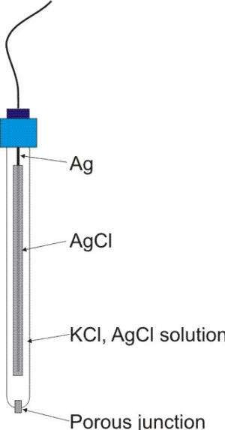
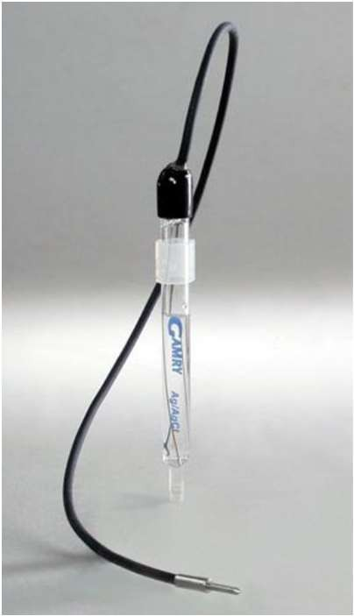
Reference electrodes
The working principle of the Ag/AgCl electrode is based on the concept of a half-cell reaction, which involves the transfer of electrons between the electrode and the electrolyte.
The silver ions then react with the silver wire to form metallic silver, while the chloride ions remain in the electrolyte.
Silver-Silver Chloride Reference Electrode
Eº = +0.197V
The Ag/AgCl electrode is widely used as a reference electrode in electrochemical studies due to its stable and reproducible electrode potential reference
Convenient
Common problem is porous plug becomes clogged
Standard Hydrogen Electrodes (SHE) or NHE are cumbersome
Requires H₂ gas and freshly prepared Pt

Slide 3
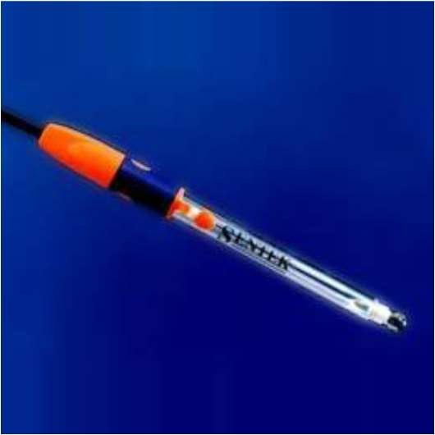
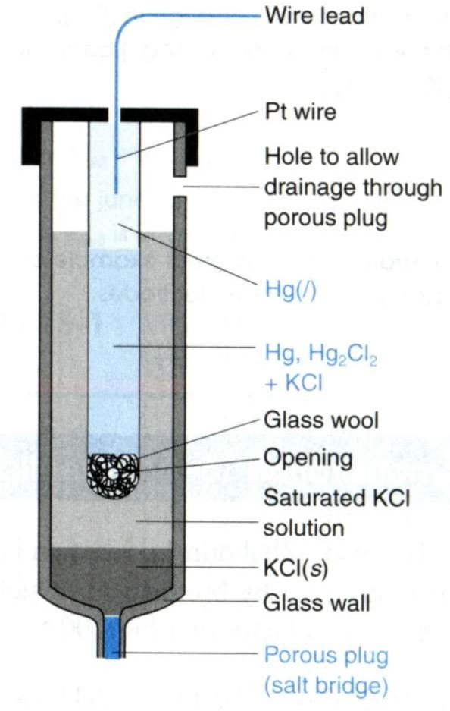
Reference electrodes
Saturated Calomel Reference Electrode (S.C.E)
Eº = +0.240
➢
Saturated KCl maintains constant [Cl⁻] even with some evaporation
➢
But, S. C. E. requires handling of Hg (l)
- Toxicity issues
Thus, Ag/AgCl reference electrodes are more commonly used!
➢

Slide 4
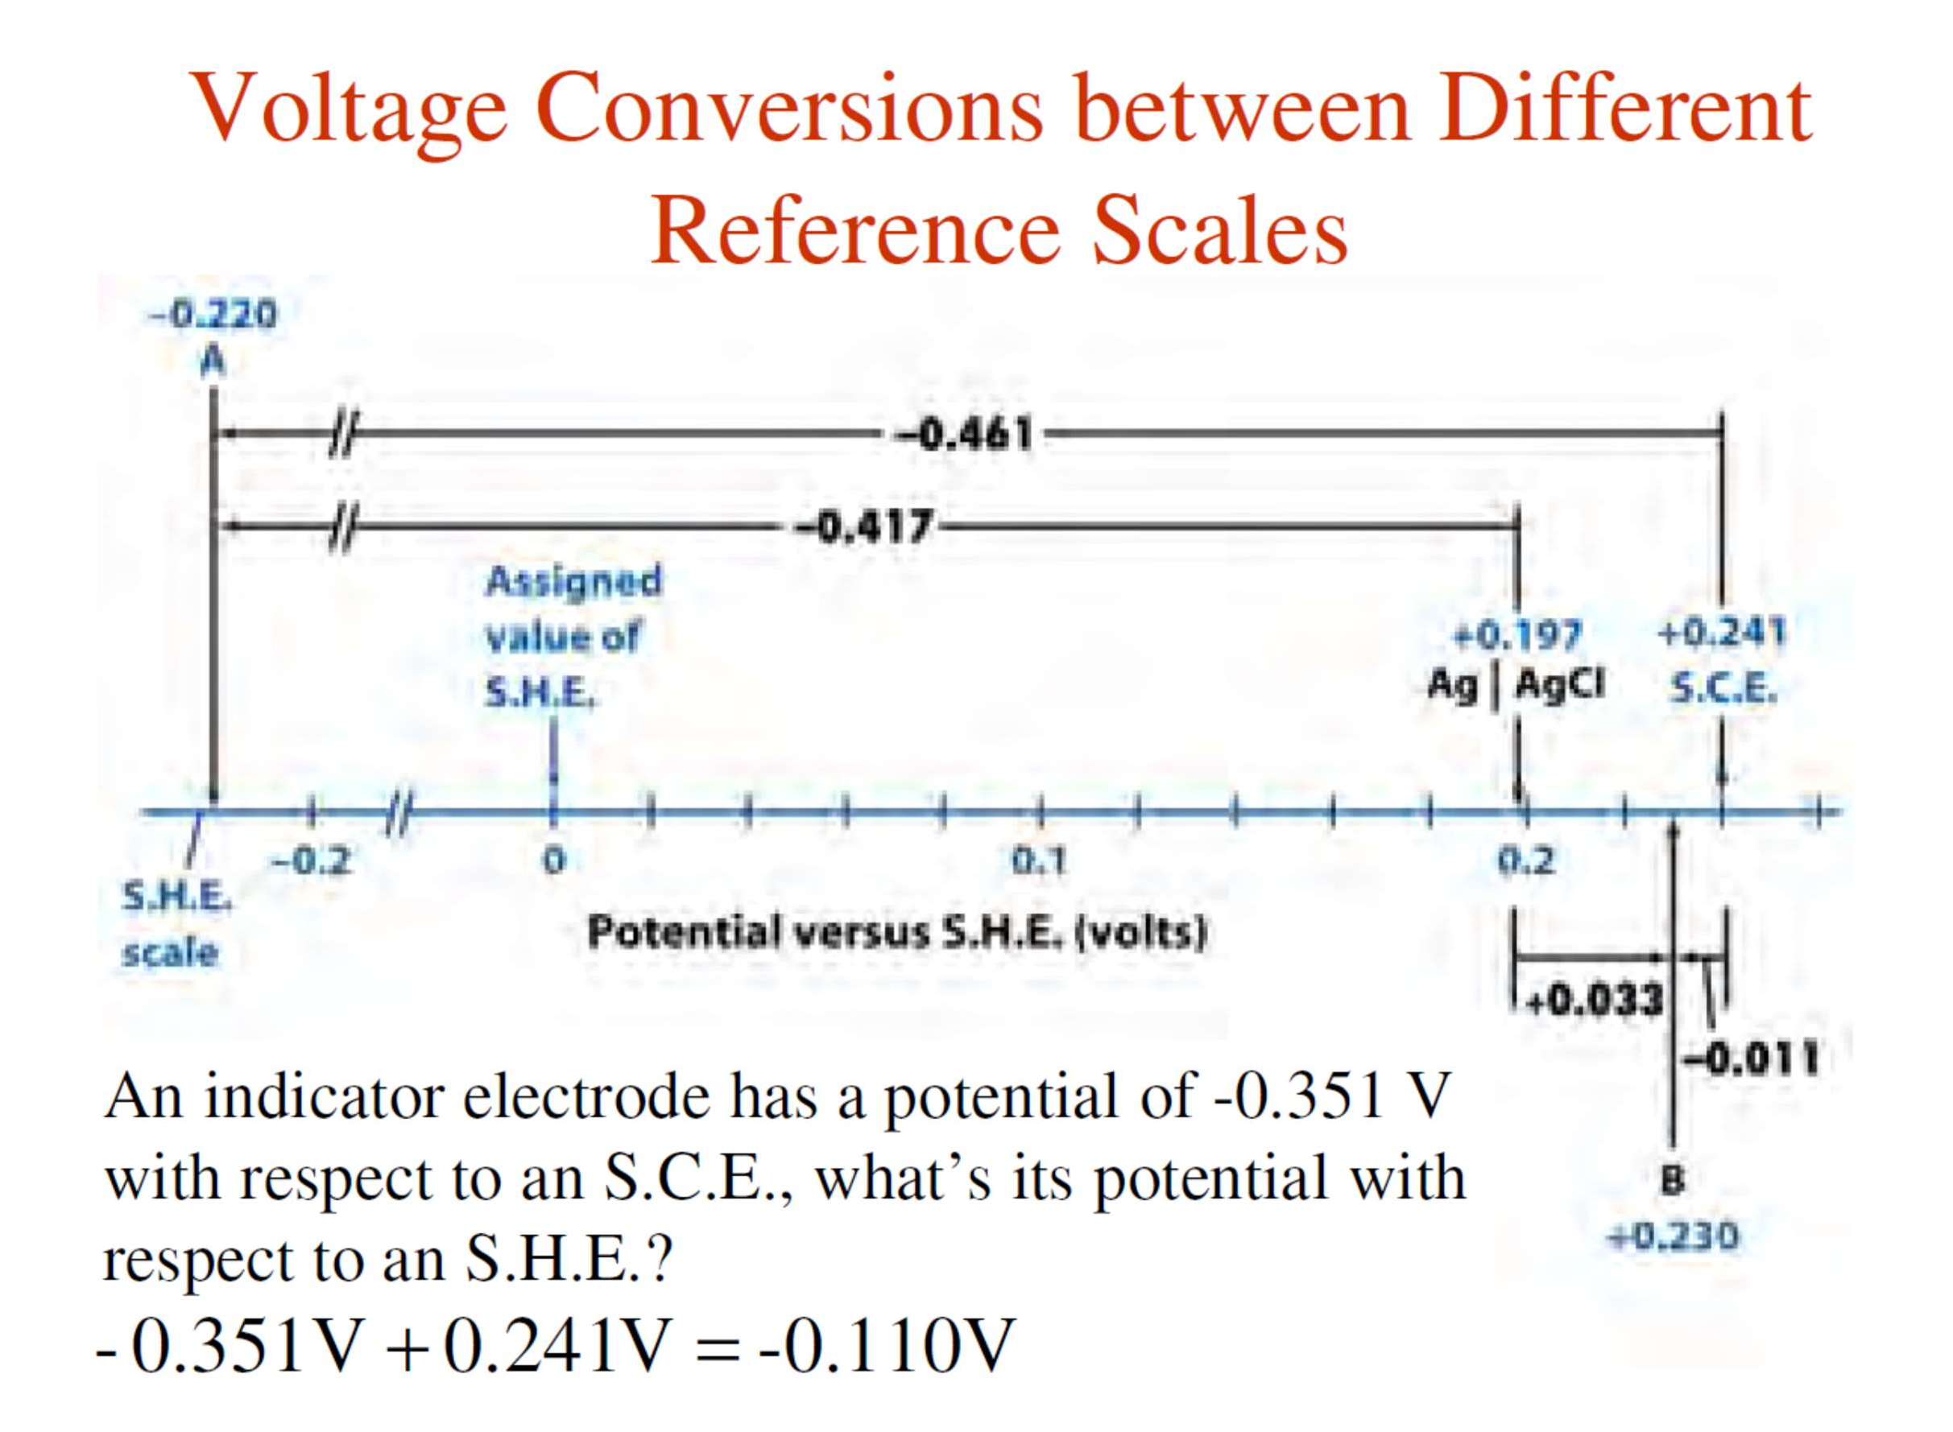

Slide 5
Redox stability (Influence of pH)
Many redox reactions in aqueous solution involve transfer of H⁺ as well as electrons and the electrode potential therefore depends on the pH.
For a redox couple in which there is transfer of e⁻ electrons and H⁺ protons
The half-reaction for the perchlorate/chlorate (ClO₄⁻ / ClO₃⁻) couple is
At pH=0, E’ is +1.2 V at pH 7
1.2 -2/2(7x0.059)V
+0.78 V
Ln x = ln 10.lnx
=
ln[H⁺] = ln 10. log[H⁺] with pH =- log[H⁺],
The potential decreases when the pH increases.

Slide 6
Redox stability (reaction with water)
Water as oxidizing agent
For equivalent hydronium ions
Water as reducing agent
At a partial pressure of O₂ is 1 bar
The variation of the reduction potentials of water with pH. The sloping lines defining the upper and lower limits of thermodynamic water stability are the potentials for the O₂ /H2O and H/H2 couples, respectively. The highlighted portion represents the stability range of natural waters.
Acidified water is a poor reducing agent, however, for Eº (Co³⁺, Co²⁺) = +1.92 V
Higher pH favors oxidation
water oxidation occurs generally at higher potential due to kinetic barrier (4 e process) and due to formation of O-O bond

Slide 7
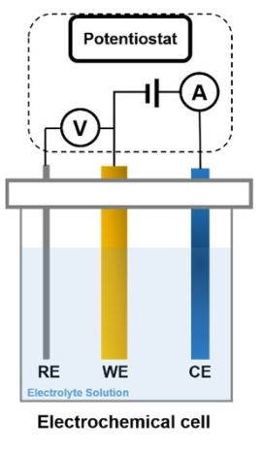
Three electrode setup
RE-reference electrode
WE-working electrode
CE-counter electrode

Slide 8
Ion selective electrodes
Liquid junction potential can arise when two different solutions are in contact. Although they are not good, under some circumstances this potential between two solutions can be used to measure the relative concentrations of the two solutions
we have two solutions, with different concentrations, which are separated by a barrier or membrane which has been carefully designed so that it is only permeable to one kind of ion. Let us assume that this ion is M+
Diffusion favours a flow of M+ from the more concentrated to the less concentrated solution, as indicated by the arrow.
Such a flow leaves an excess of negative counter-ions on the right and an excess of positive charge on the left, as shown in (b).
This charge separation opposes the flow and so eventually a situation is reached in which no further flow occurs and the potential across the barrier reaches a steady value
The potential can be measured by creating a cell in which a reference electrode is dipped into each solution, as shown in (c).

Slide 9
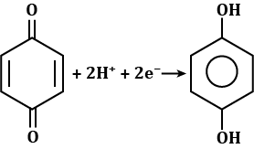
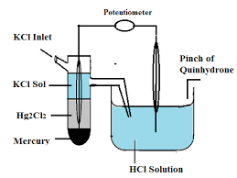
Determination of pH of a Solution
Quinhydrone Electrode
quinhydrone dissociates in water giving equal concentration of quinone and hydroquinone
Q + 2H⁺ + 2e⁻ = QH₂
0.059.pH
pH = (0.6994 – E_{SCE} – E_{cell})
0.0592

Slide 10
Determination of pH of a Solution
Glass Electrode
The glass electrode (indicator electrode) is an ion –selective electrode made of a doped glass membrane that is selective to specific ions.
pH electrode is an example of glass electrode which is sensitive to H⁺ ions.
A potential is built up across the thin glass membrane due to ion exchange between the Na+ ions in the glass and the H+(aq) ions in the internal and external solutions.
This potential is measured between the AgCl/Ag electrode built into the assembly and a second reference electrode (calomel electrode) which is dipped into the solution under test.
A silver wire in this solution forms a Ag – AgCl reference electrode
E_{cell} = E _{calomel} – E _{glass electrode}
E_{glass electrode} = Eº_{glass electrode} +0.059pH
pH = (0.241 – Eº_{G} – E_{cell})
0.0592
Eº_{G} can be calculated using solution of known H⁺ concentration

Slide 11
Pourbaix Diagram
Pourbaix diagram also know as potential Vs pH diagram, provides information on the conditions of pH and potential under which a species is thermodynamic stable.
This reaction does not involve H⁺ ions, so its potential is independent of pH and represented by a horizontal line.
If the environment contains an oxidizing couple with a potential above this line (more + ve), then Fe³⁺ will be the major species.
The horizontal line towards the top left of the diagram is a boundary that separates the regions where Fe³⁺ and Fe²⁺ dominate.
Consider another reaction
There is no electron transfer occurs in this reaction and so independent of potential. However, the reaction depends on the pH of the environment.
Pourbaix diagram for some important naturally occurring aqua species of iron
At low pH, Fe³⁺ is favoured and at high pH Fe(OH)₃ is favoured.
Fe³⁺ is the dominant species in the solution if its concentration exceeds 10 μmol/dm³

Slide 12
Natural waters
When fresh water is in contact with the atmosphere, it is saturated with O₂, and many species may be oxidized by this powerful oxidizing agent.
Reduced forms are found in the absence of oxygen, especially where there is organic matter to act as a reducing agent
The major acid system that controls the pH of the medium is CO₂/H₂CO₃/HCO₃/CO₃⁻², where atmospheric CO₂ provides the acid and dissolved carbonate minerals provide the base.
The CO₂ which is acidic lowers the pH and makes the potential more “+” ve. The reverse process, photosynthesis, consumes CO₂, thus raising the pH and making the potential more negative.
At the surface, the water is fully oxygenated and the iron must be present in particles of the insoluble FeO(OH); these particles tend to settle.
At greater depth, the O₂ content is low. If the organic content or other sources of reducing agents are sufficient, the oxide will be reduced and iron will dissolve as Fe2+.
The Fe(II) ions will then diffuse towards the surface where they encounter O₂ and are oxidized to insoluble FeO(OH) again
Regions typical of various natural waters.

Slide 13
Pourbaix diagram: corrosion
Corrosion-metal dissolution occurs
Passivation-formation of insoluble oxides on the surface
Immune-where the metal is stable

Slide 14
Sacrificial anodes and cathodic protection
Stainless steel is composed majorly of Fe and Carbon with 10% Cr.
Cr protects the stainless steel against corrosion by the formation of a thin oxide layer (Cr₂O₃) over the surface of the steel.
The oxide layer passivates the steel and is self-repairing. That is if the oxide coating is scratched off, further oxidation of the chromium in the steel occurs to repair it.
The stainless steel walls of the Walt Disney concert hall in Los Angeles
In the absence of Zn, Fe is oxidized and is precipitated in the form of Fe(OH)₂. If sufficient O₂ is available, further oxidation results in the formation of the familiar red-brown (‘rust-coloured’) Fe₂O₃H₂O.
For Zn-coated steel, oxidation of Zn is thermodynamically more favourable than that of Fe, and so the corrosion (rusting) of the steel is inhibited. Furthermore, the Zn²⁺ ions precipitate as Zn(OH)₂ (K_{sp} = 7 x 10⁻¹⁷), forming a deposit around the scratched area providing further protection for the steel.
For example, in sea water metal blocks (Mg or Zn) are used to protect the cathode. Fe will never be able to function as anode.

Slide 15
Electrodeposition: to prevent corrosion
Electrodeposition of a metal over the other can protect the base metal against corrosion. Often a layer of an inert metal is deposited over the base metal.
In a first step, the reduction of a cation on the substrate surface (aided by an applied potential or current) to form an adatom, and its migration over the surface to an energetically favourable site.
Other atoms get electrodeposit with the first, forming the nucleus of a new phase
The nucleus grows parallel and/or perpendicular to the surface. A number of nuclei can form and grow on the surface
This will continue to form few layer of metals which protect the oxidation of the base metal.
This process is controlled by the potential applied
Electroless plating
It is an autocatalytic reaction on the metal surface after nucleation has begun. A reducing agent R reduces metal ions to the corresponding metal on the substrate surface by undergoing surface-induced oxidation.
Ni²⁺ + H₂PO₂⁻ + H₂O → Ni + H₂PO₃⁻ + 2H⁺

Slide 16
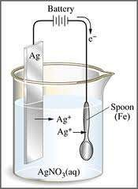
Electrolysis: Electroplating
Negative Electrode
Is the OBJECT TO BE PLATED
so the positive metal ions would go towards it and be REDUCED.
It is the CATHODE
Red: Ag⁺ + 1e- → Ag⁰
Positive Electrode
Made of plating metal
It dissolves into solution as metal strip gets OXIDIZED.
It is the ANODE
This replenishes the ions for plating.
Ox: Ag⁰ → Ag⁺ + 1e⁻

Slide 17
Electrolysis: Electroplating
If 10 amps are run through a CuSO₄ solution for 5 minutes, calculate the grams of Cu that will plate onto the spoon
Cu²⁺ + 2e⁻ → Cu
1 mole Cu = 63.5 grams
Coulombs = # amps x seconds
m = M.I.t/nF
m -mass of substance
M -molecular weight of the substance
I -current passed (A)
t -time for which the current is passed (s)
n -number of electrons transferred
F -Faraday constant (96475 C / eqv)
= 63.5 x 10 x 300 s / 2 x 96500
= 0.987 g

Slide 18
Latimer Diagram (Potential Diagram)
A Latimer diagram summarizes information (electrochemical potential) in a compact form and (as we explain) shows the relationships between the various species in a particularly simpler way.
• Electrochemical potential values are written for successive redox reactions (from highest to lowest oxidation state),
typically under standard conditions in either strong acid ([H⁺] = 1 M, pH 0) or strong base ([OH⁻] = 1 M, pH 14).
The oxidation states of successive substances in a Latimer diagram can differ by one or more electrons.
Assign the oxygen atoms an oxidation state of -2 and the hydrogen atoms an oxidation state of +1.

Slide 19
Conversion of a Latimer diagram to a half-reaction often involves balancing elements by including the predominant species present in acidic aqueous solution (H and H₂O)
In basic medium at pH = 14
The E value for Cl₂/Cl⁻ is same in both acidic and alkaline as no proton transfer involved

Slide 20
To calculate E for nonadjacent couple or not listed in the Latimer diagram. Use ΔG = -nFE
To find the std potential for the composite process, convert the corresponding individual Eº values to ΔG by
multiplying with –nF and sum them up and convert them to Eº by dividing by –nF.
The net result

Slide 21
For example, to calculate the Eº value for ClO₂⁻ /Cl₂ in basic solution.

Slide 22
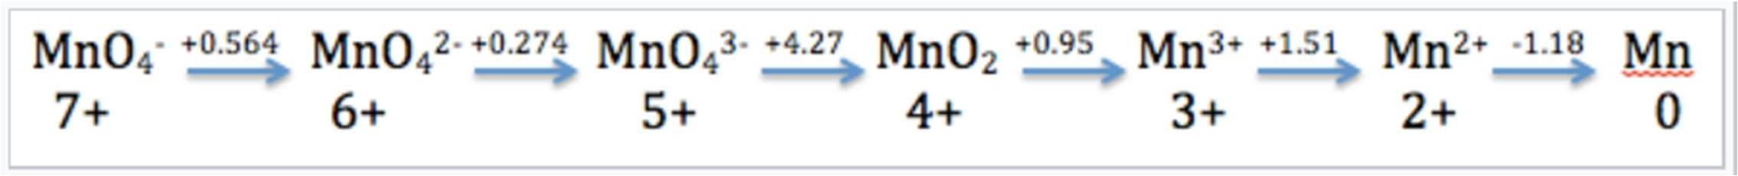
The Latimer diagram for Mn illustrates its standard reduction potentials (in 1 M acid) in oxidation states from +7 to 0.
For example, for the 5-electron reduction of MnO₄ – to Mn²⁺
Eº = [ (0 . 564) + 1(0 . 274) + 1( 4 . 27) + 1( 0 . 9 5) + 1(1.51)] / 5 = +1.51V
for the three-electron reduction of MnO₄ (aq) to MnO₂(s),
Eº = [1(0.564) + 1(0.274) + 1(4.27)] / 3 = +1.70V

Slide 23
Disproportionation
A species has a tendency to disproportionate into its two neighbors if the potential on the right of the species in a Latimer diagram is higher than that on the left
K > 1 for this reaction if E > 0. The overall reaction is
The standard potential for the overall reaction is E° = E° (R) - E° (L), which is positive if E° (R) > E° (L).
Then, the species is unstable and has a tendency to disproportionate.

Slide 24
